Slide 1




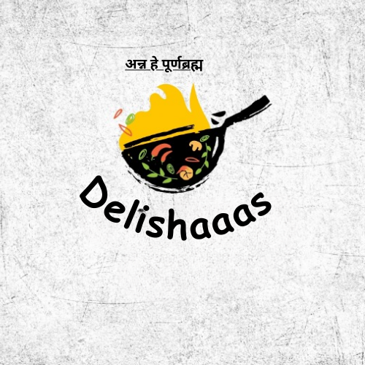
TEAM VSC
HACKTOBERFEST 1.0

Slide 2






Problem statement
Online Cook Book
Its ironic that just by seeing a shot form cooking video we think that we can recreate the same . It seems so easy but in reality we really find it hard to make the same thing which can also be delicious. Hence to make it more easier and fun for the users to know the recipes and make some delicious food for themselves or their friends and family
https://www.statista.com/statistics/1288261/global-sources-meal-inspiration-by-generation/

Slide 3




Solution
Delishaaas – An online website which will make you feel like you are a star chef and you can also create different cuisines, recipe. Star recipes
Preservation of Heritage and Traditions: Family recipe books allow you to document and pass down generations of culinary heritage. This ensures that traditional recipes, cooking techniques, and cultural flavors are preserved and cherished by future family members.
Cost-Effective: Cooking at home using family recipes can be more cost-effective than dining out or relying on pre-packaged foods. This can also lead to healthier eating habits.

Slide 4


Key Features and Functionality
1. Ingredients: They list the ingredients required for each recipe, along with specific quantities and measurements.
2. Serving Suggestions: Some cookbooks provide serving suggestions, tips on garnishes, and ideas for presentation.
3. Dietary Information: Many modern cookbooks include dietary information, such as nutritional facts, allergen warnings, and suitability for various diets (e.g., vegetarian, vegan, gluten-free).

Slide 5
Key Features and Functionality
1. Recipes: Cookbooks contain a collection of recipes, each with detailed instructions on how to prepare a specific dish.
2. Cooking Instructions: Detailed step-by-step instructions guide the reader through the cooking process, including techniques, cooking times, and temperatures.
3.Kitchen Tips: Cookbooks may offer cooking tips, ingredient substitutions, and advice on kitchen equipment.

Slide 6


Social impact
Cultural Preservation: Our website contain traditional and regional recipes, preserving cultural culinary heritage. They help maintain and share the unique flavors and food traditions of different cultures.
Health and Nutrition: Our Website focus on healthy recipes and nutritional information can promote better eating habits and overall health. They contribute to raising awareness about balanced diets and dietary restrictions.
Community Building: Website often feature recipes shared by community members, Food Bloggers . They can foster a sense of belonging and shared culture within a community, whether it's a family, a group of friends, or an ethnic group.

Slide 7


Revenue Model
Revenue model can be based on the traffic which comes to the site.
Some can be defined as:
ADS – Ads can be run through the website .
Recommendation of Cookware Equipment.
Cookbook which contain all the recipes.
Express Your Gratitude - where people will have community and saying thanks is a great way to let them know you appreciate their shout out.

Slide 8



Technologies Used
OUR TEAM UTILIZED A VARIETY OF TECHNOLOGIES INCLUDING PROGRAMMING LANGUAGES LIKE JAVA AND PYTHON, AS WELL AS TOOLS LIKE GITHUB AND AWS.

Slide 9




The Team
VishnuPriya
22MIS7050
Shrawani
22BCE9256
Chirag
22BCE9167
CEO
CTO
CMO

Slide 10


Thank You
HACKTOBER FEST

